Slide 1
Natural Language Processing with Disaster Tweets
Pulak Raj and Chaitanya Vallabhaneni
Group 5

Slide 2
Data Mining Steps
1
2
3
4
5
6
Problem Definition
Data Preparation
Data Exploration
Modeling
Evaluation
Deployment

Slide 3
Introduction
The first place many people go to in order to send or receive information is Twitter
In order to find locations of disaster and the scope of these disasters, disaster relief organizations and news agencies can look at tweets
Takes too long and is too slow to look at every tweet manually

Slide 4

Problem Definition
Predict which tweets are about disasters and which aren’t
Helps agencies to quickly identify disasters

Slide 5

Overview
Challenge is in finding the difference between a metaphorical tweet and a disaster tweet

Slide 6
Data
Source: https://www.kaggle.com/c/nlp-getting-started/data
Size: 10000 total tweets relating to or not relating to disasters
Format: ID, text, keyword, location
Will extract hashtags and locations from tweets as another column
We may stream in tweets in order to have more data to train and test the data but these tweets would require manual labeling

Slide 7
Data Mining Steps
1
2
3
4
5
6
Problem Definition
Data Preparation
Data Exploration
Modeling
Evaluation
Deployment

Slide 8
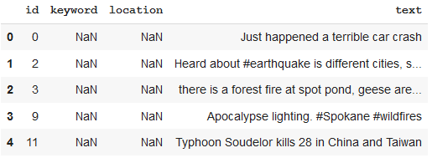
Data Preparation
Extracted missing locations from text if location is present in text
Removed duplicate values

Slide 9
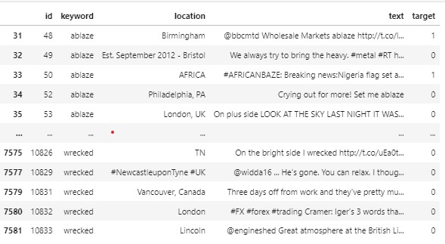
Data Preparation

Slide 10
Data Cleaning
Lots of unnecessary words and characters
Removed URLs
Removed HTML tags
Removed Emojis
Removed punctuation (We will try with and without punctuation)
Spell correction to get consistent words
All words set to lowercase

Slide 11
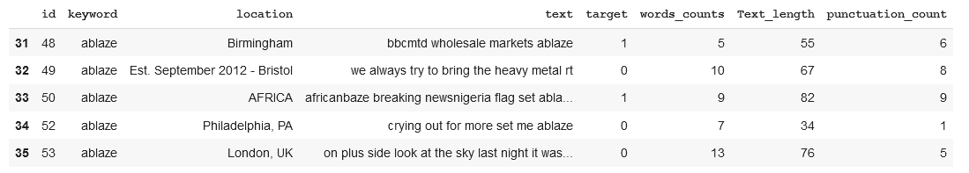
Data Cleaning

Slide 12
Methods of Evaluation
Classification accuracy score
Confusion matrix
Precision and Recall
F1-Score
Criteria of Success: F1-Score

Slide 13
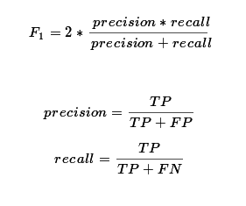
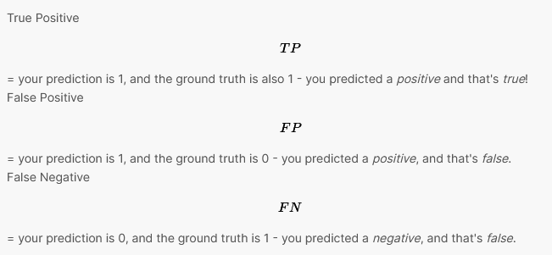
Methods of Evaluation

Slide 14
Data Mining Steps
1
2
3
4
5
6
Problem Definition
Data Preparation
Data Exploration
Modeling
Evaluation
Deployment

Slide 15
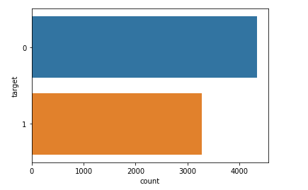
Disaster Tweet Count

Slide 16
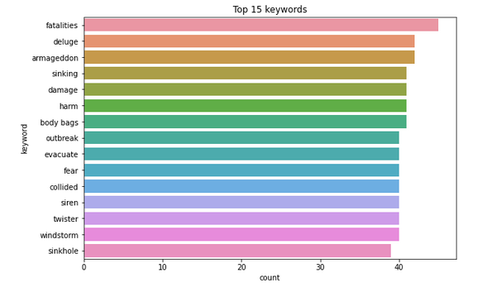
Top Keywords

Slide 17
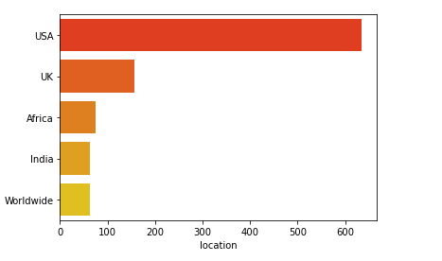
Top Locations

Slide 18
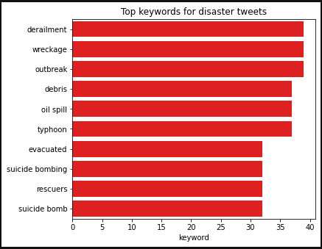
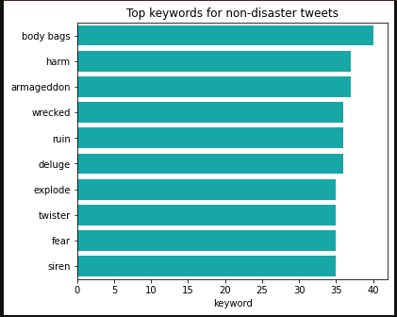
Keywords for Disaster Tweets

Slide 19
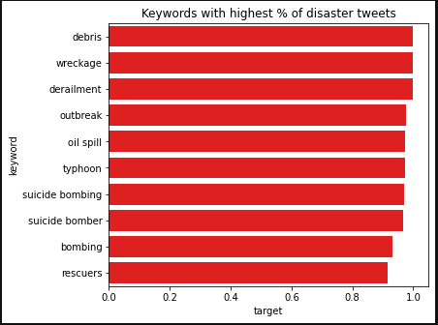
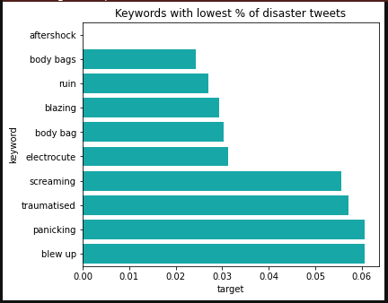
Keywords for % of Disaster Tweets

Slide 20
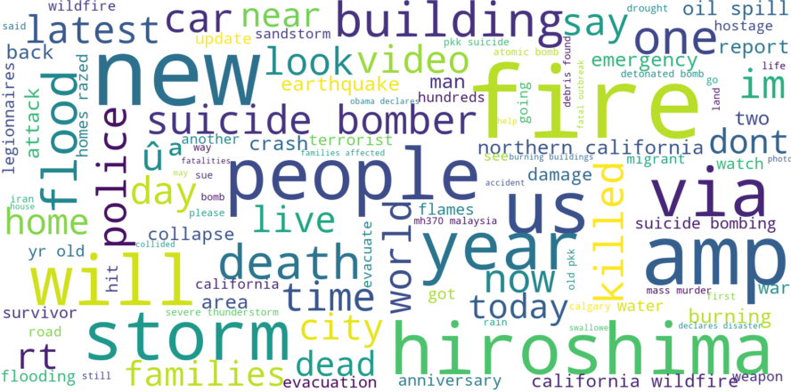
Word Cloud: Disaster Tweets

Slide 21
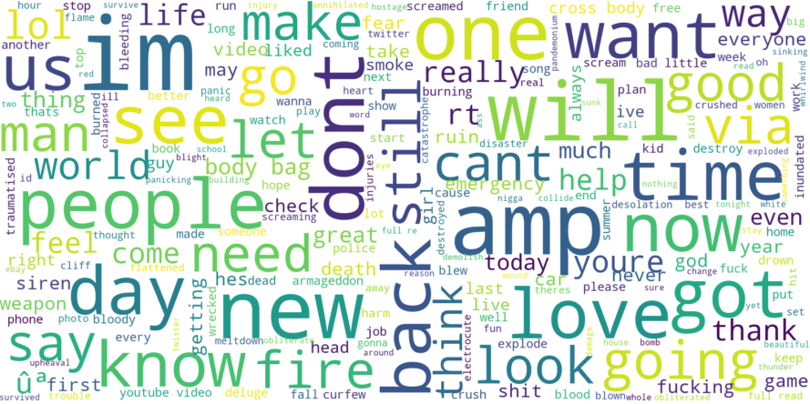
Word Cloud: Non-Disaster Tweets

Slide 22
Data Mining Steps
1
2
3
4
5
6
Problem Definition
Data Preparation
Data Exploration
Modeling
Evaluation
Deployment

Slide 23
Embedding
One-hot Vectors
If n words, then each word is represented by a 1xn dimensional vector
Skip-gram Model
Predict surrounding words given a target word (input to predict context)
Good for small data and rare words
Continuous Bag-of-words (CBOW)
Predict word given surrounding words (context to predict word)
Much faster and better accuracy for frequent words
Skip-gram and CBOW use LOCAL CONTEXT

Slide 24
Embedding
GloVe: Global Vectors for word representation
Generates word embeddings by aggregating global word-word co-occurrence matrices from the corpus
GloVe has a pre-trained corpus model
GloVe uses ENTIRE TEXT

Slide 25



Embedding - TFIDF

Slide 26
Data Mining Steps
1
2
3
4
5
6
Problem Definition
Data Preparation
Data Exploration
Modeling
Evaluation
Deployment

Slide 27
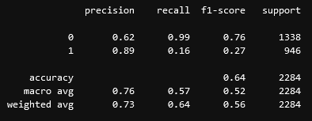
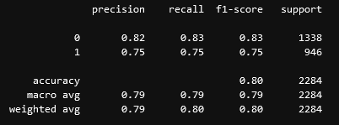
Logistic Regression
One-hot Encoding
tf-idf

Slide 28
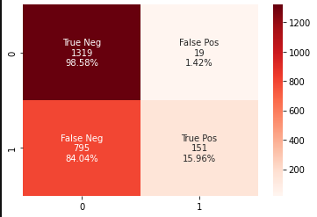
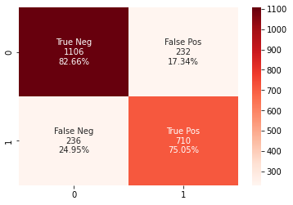
Logistic Regression
One-hot Encoding
tf-idf

Slide 29
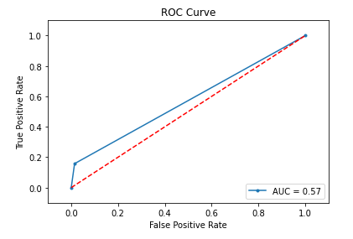
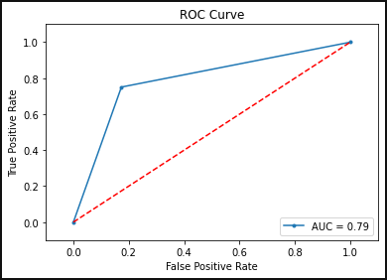
Logistic Regression
One-hot Encoding
tf-idf

Slide 30
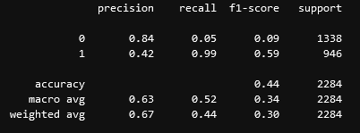
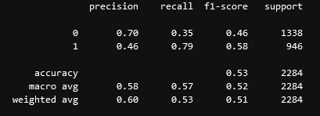
Naive Bayes
One-hot Encoding
tf-idf
Notes:
The reason Naïve Bayes may not perform too well is because by definition, Bayes’ Theorem rlies on an often-faulty assumption of equally important and independent features which results in biased posterior probabilities. Plus, Bayes Theorem assumes independent predictors but when it comes to words, the words are always pretty dependent on each other so the assumption doesn’t hold.

Slide 31
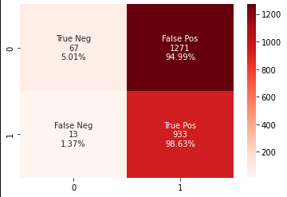
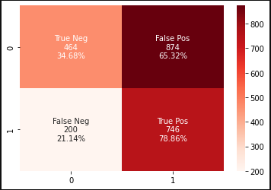
Naive Bayes
One-hot Encoding
tf-idf

Slide 32
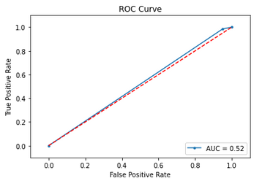
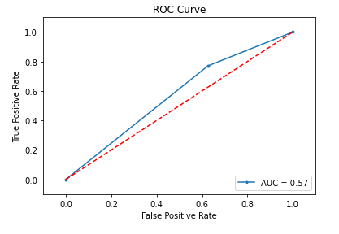
Naive Bayes
One-hot Encoding
tf-idf

Slide 33
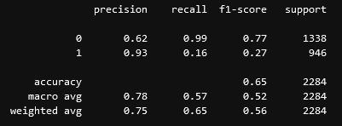
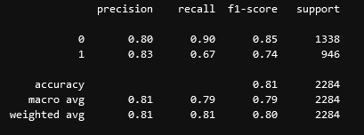
Support Vector Machine
One-hot Encoding
tf-idf

Slide 34

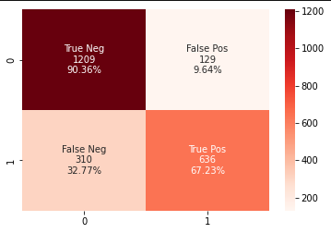
Support Vector Machine
One-hot Encoding
tf-idf

Slide 35
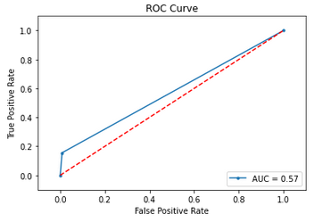
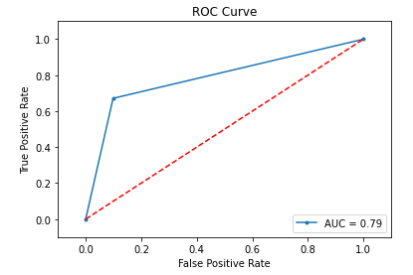
Support Vector Machine
One-hot Encoding
tf-idf

Slide 36
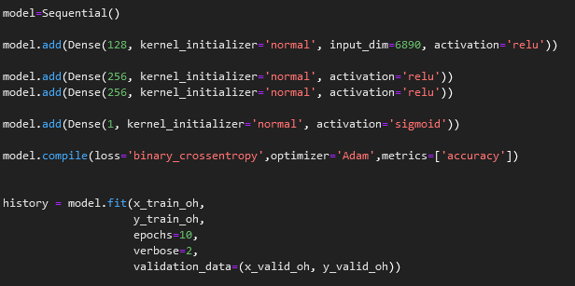
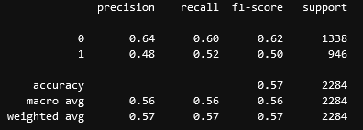
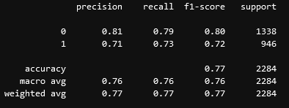
Deep Learning
One-hot Encoding
tf-idf
Notes:
Sigmoid: gives a value between 0 and 1
Binary cross entropy: compares each of the predicted probabilities to the actual class output which is either 0 or 1 and calculates the score that penalizes the probabilities based ont eh distance from the expected value. This means how close or far we are from the actual value. Commonly used in binary classification deep learning.

Slide 37
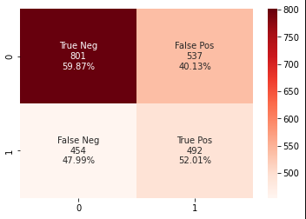

Deep Learning
One-hot Encoding
tf-idf

Slide 38
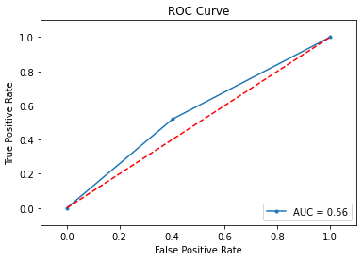
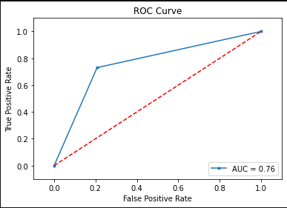
Deep Learning
One-hot Encoding
tf-idf

Slide 39
F1 Score Comparison
 | Logistic Regression | Naïve Bayes | SVM | Deep Learning
One-hot Encoding | 0.56 | 0.30 | 0.56 | 0.57
tf-idf | 0.80 | 0.51 | 0.80 | 0.77

Slide 40
Lift Calculation: TF-IDF with Logistic Regression

Slide 41
Data Mining Steps
1
2
3
4
5
6
Problem Definition
Data Preparation
Data Exploration
Modeling
Evaluation
Deployment

Slide 42
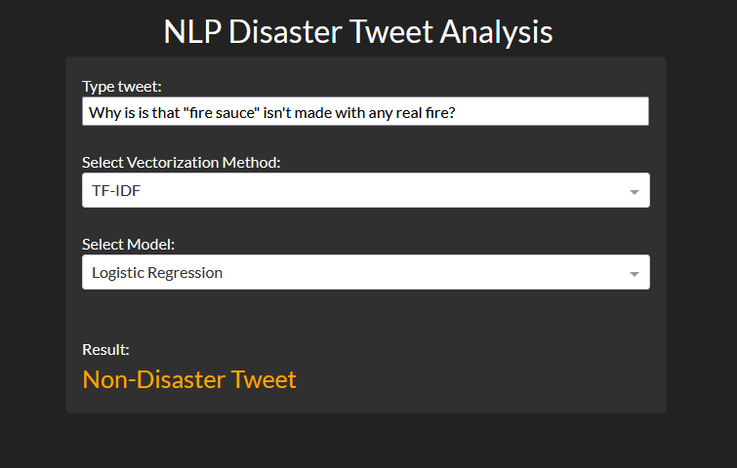
Deployment
Dashboard with model and text inputs built using Flask and Dash

